Slide 1
Perception & Attention
Computational Cognitive Neuroscience
Randall O’Reilly

Slide 2
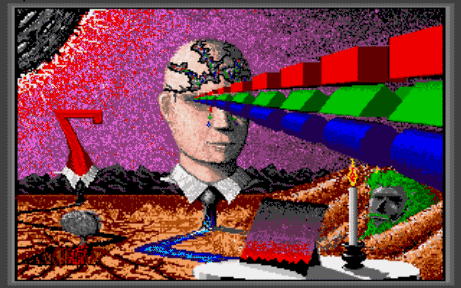
Perception Overview

Slide 3
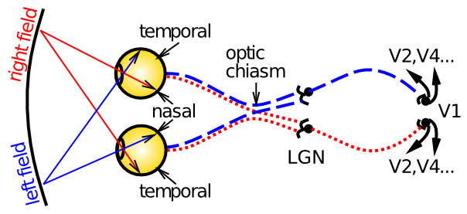
Optic Pathway

Slide 4
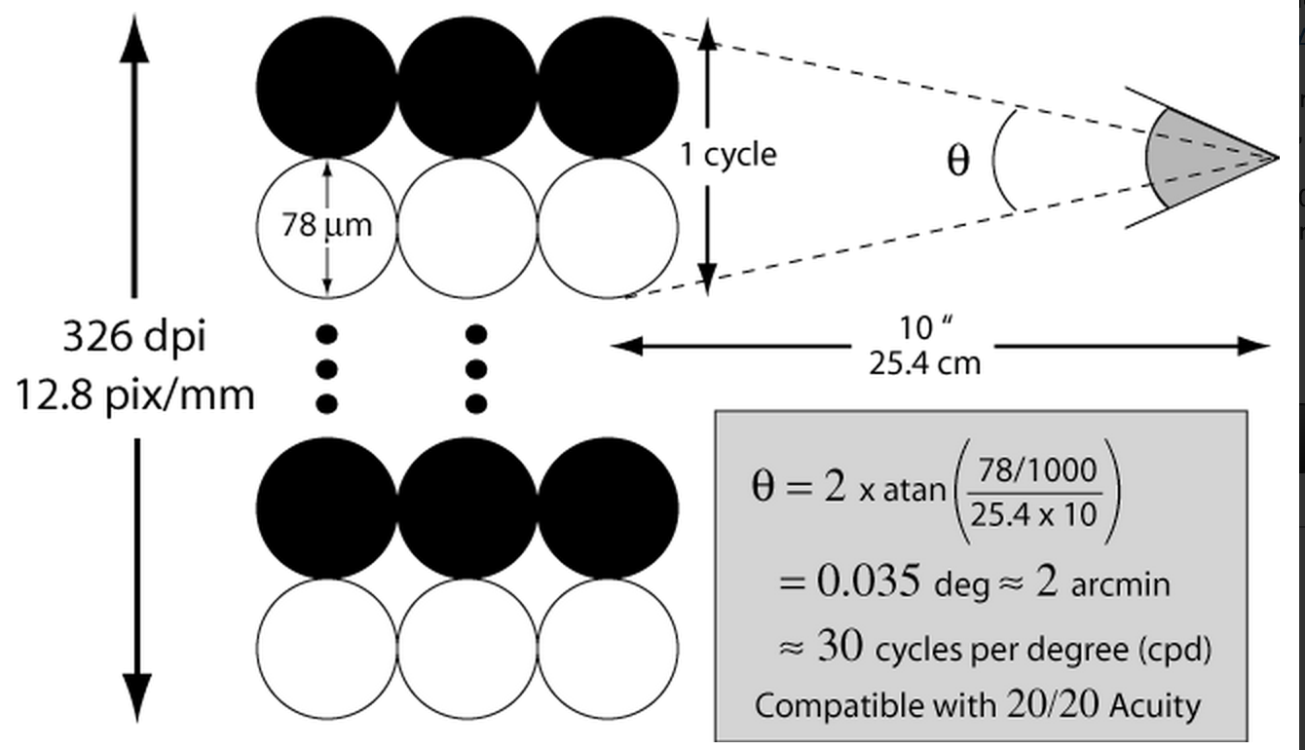
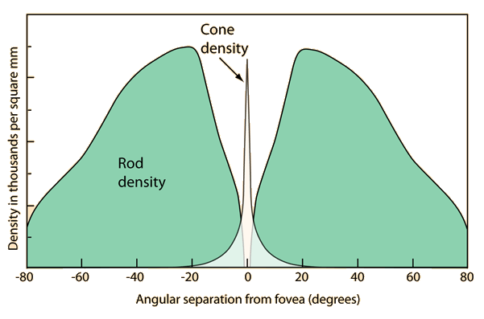
How Many Megapixels??
Retina has ~100 mega-rods, only ~5-7 mega-cones
Fovea can resolve about 30 cycles-per-degree (requires cone spacing of ~.3 arcmin) = ~300 dpi at 10” (close!)
Focal length of human eye is ~22mm, max ISO about 800

Slide 5
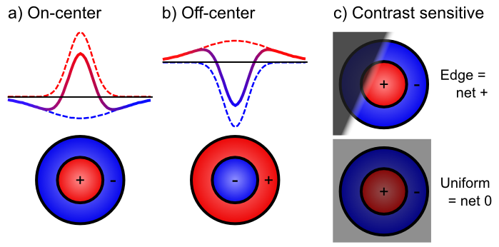
Retinal Contrast Filtering

Slide 6
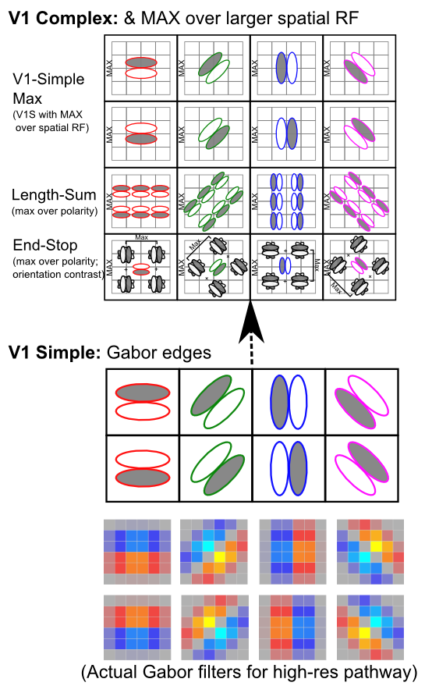
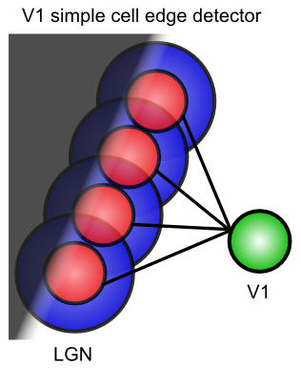
V1

Slide 7
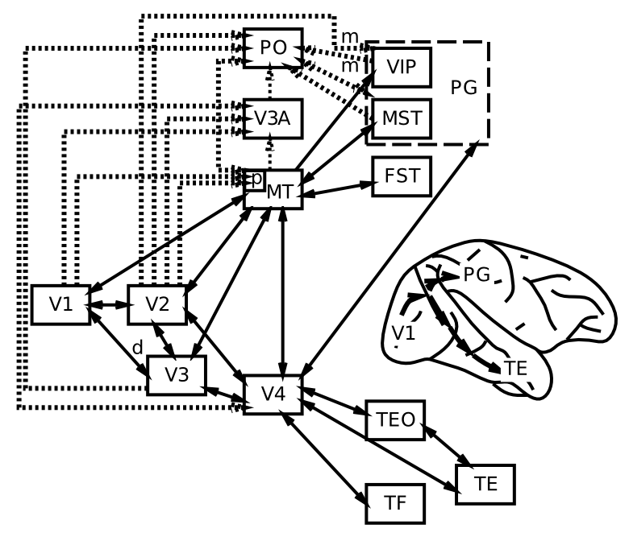
Visual Hierarchy: What vs Where

Slide 8
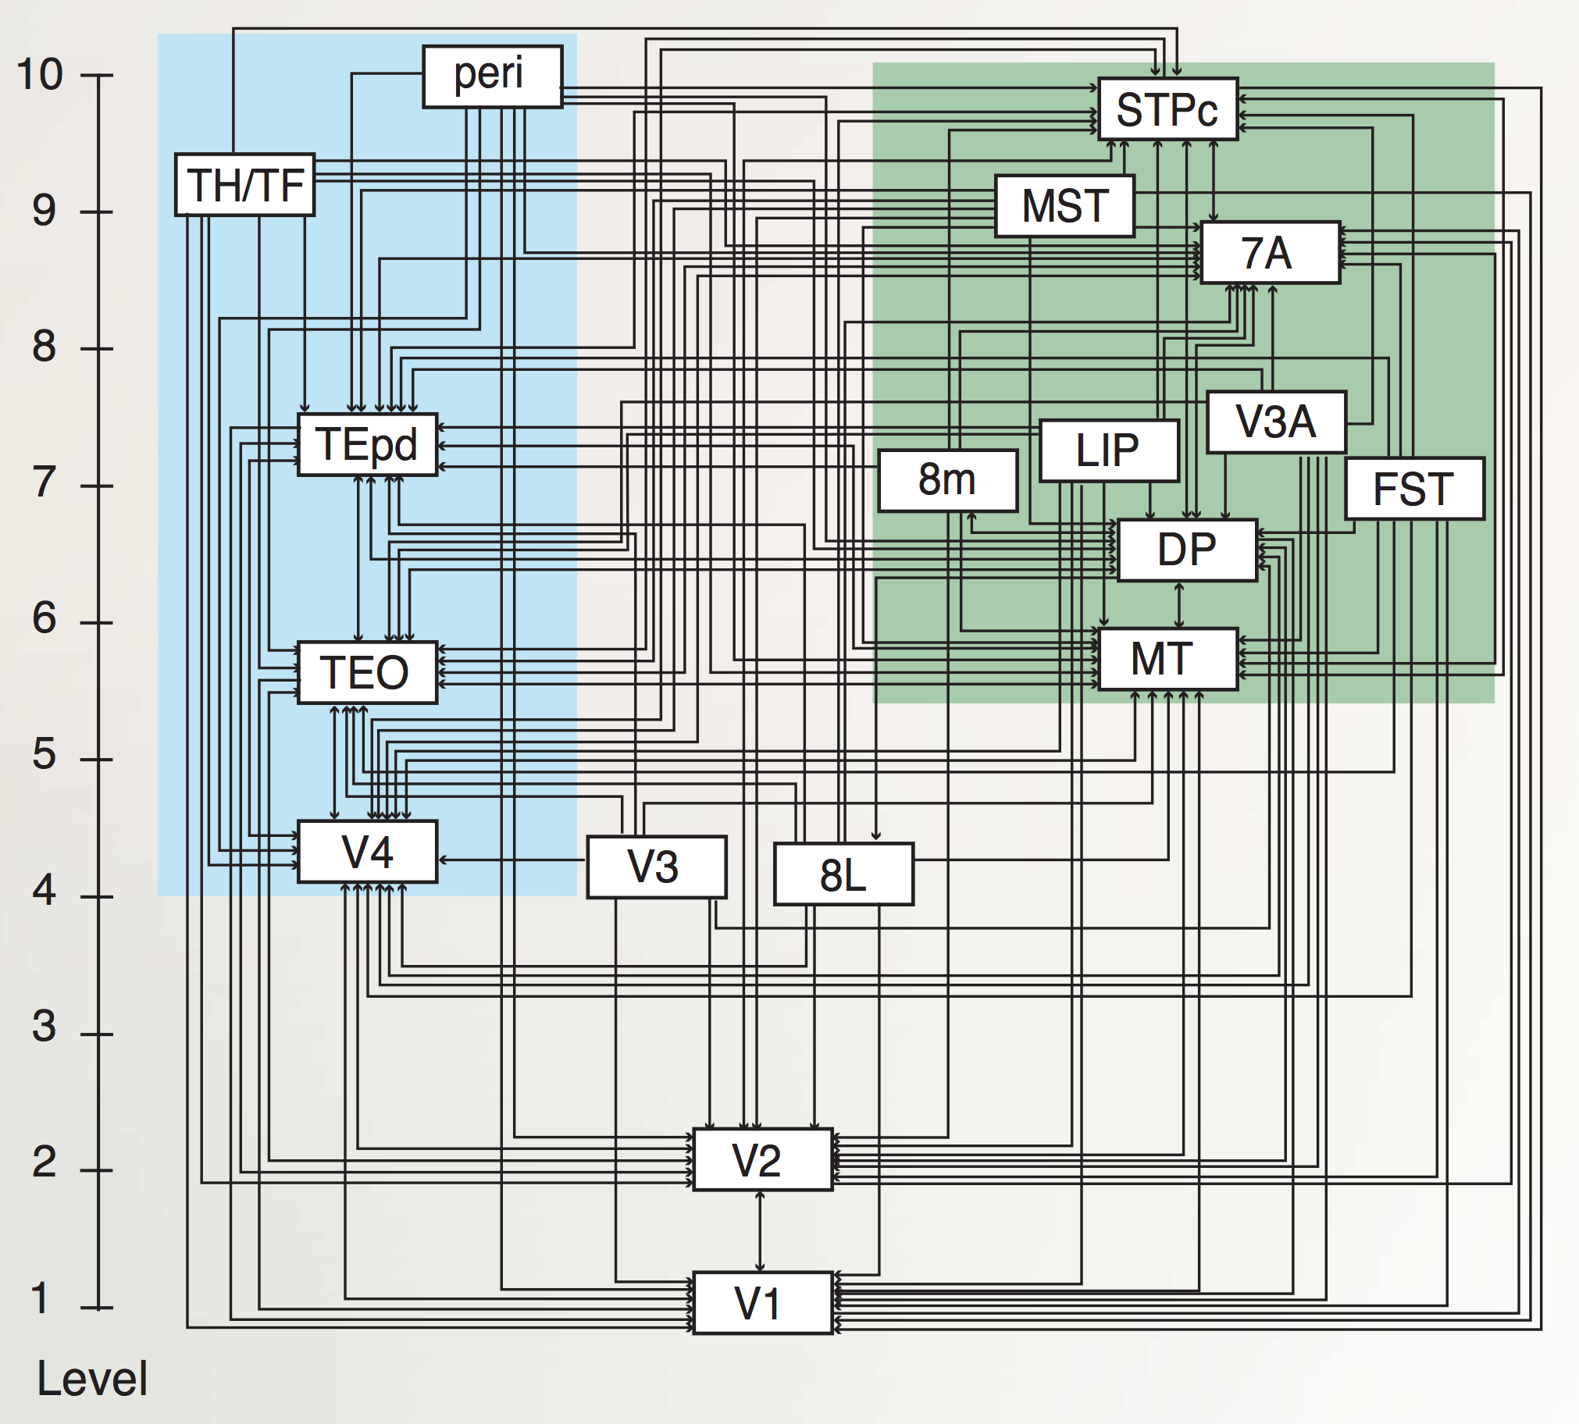
“Van Essen” Hierarchy
TE.. = Temporal
LIP, DP.. = Parietal
8L = Frontal Eye Field
To hippocampus:
TH/F = Parahippo
peri = Perirhinal
Markov et al., 2014

Slide 9
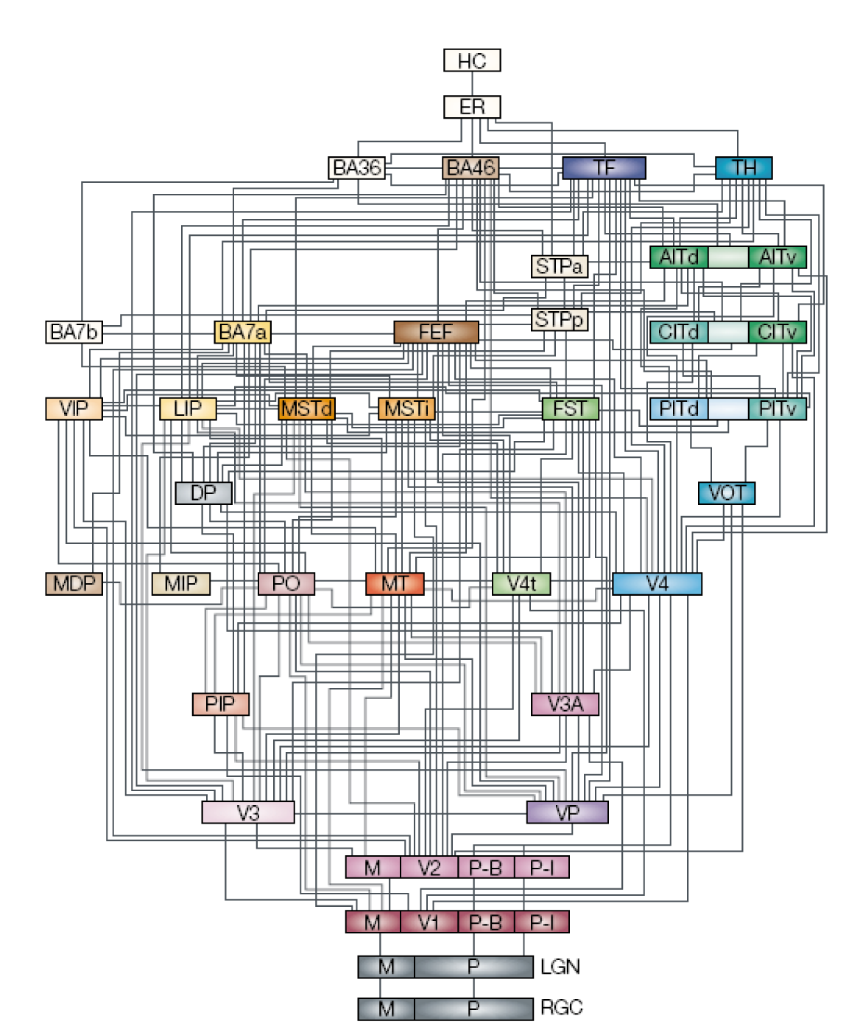

Slide 10
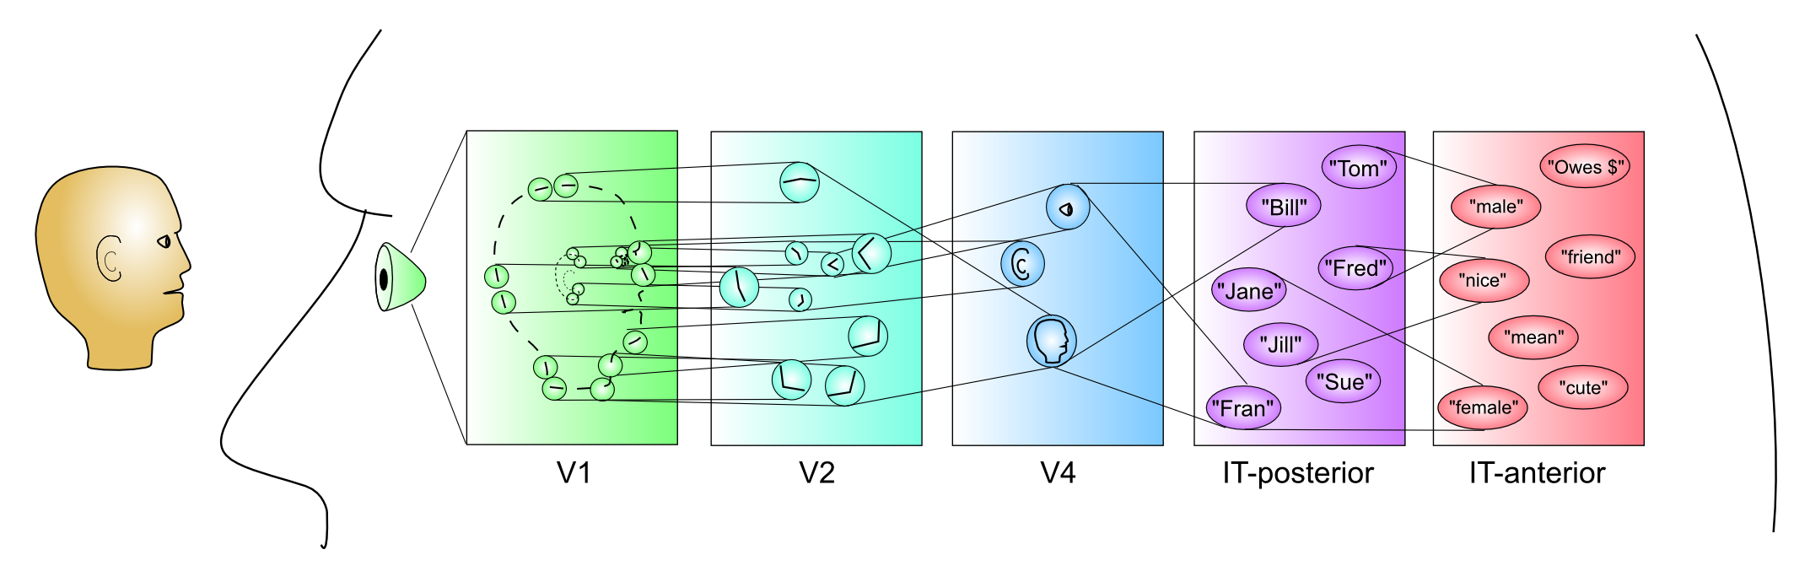
Hierarchy of Detectors..

Slide 11
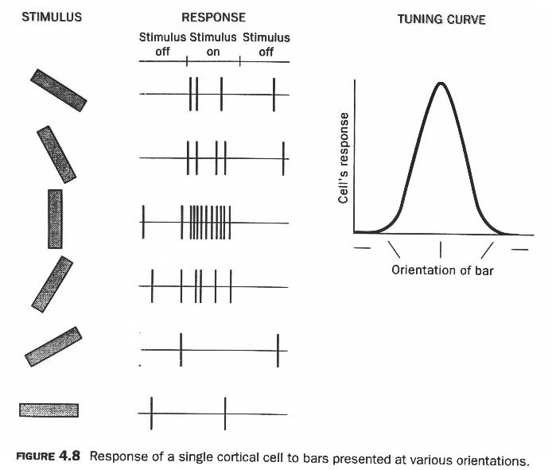
Self-Organization of V1 Orientation Selective Neurons

Slide 12
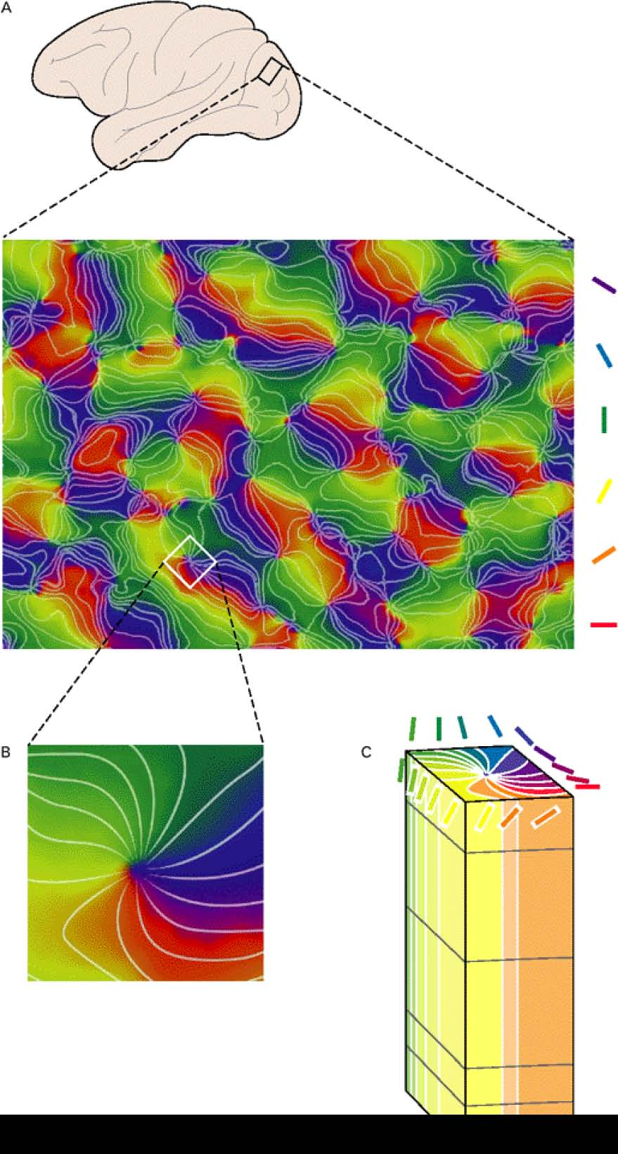
Topography!
Map of orientations
“Pinwheel” singularities
Hypercolumn organization

Slide 13

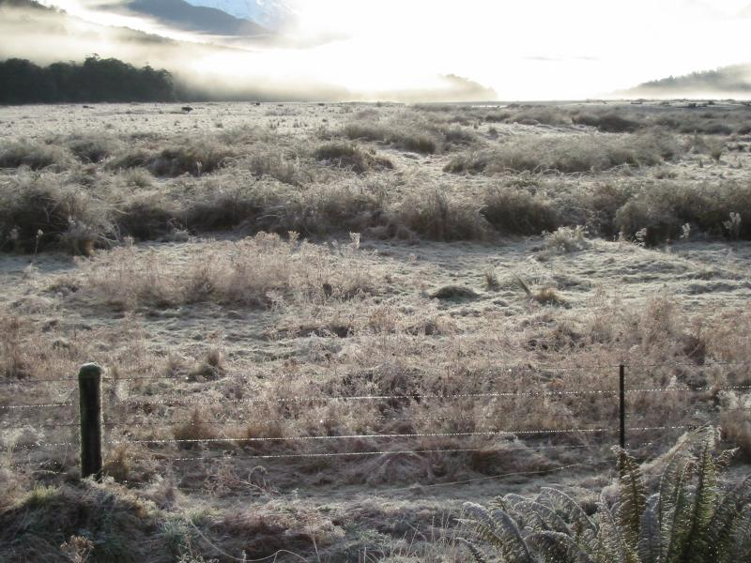
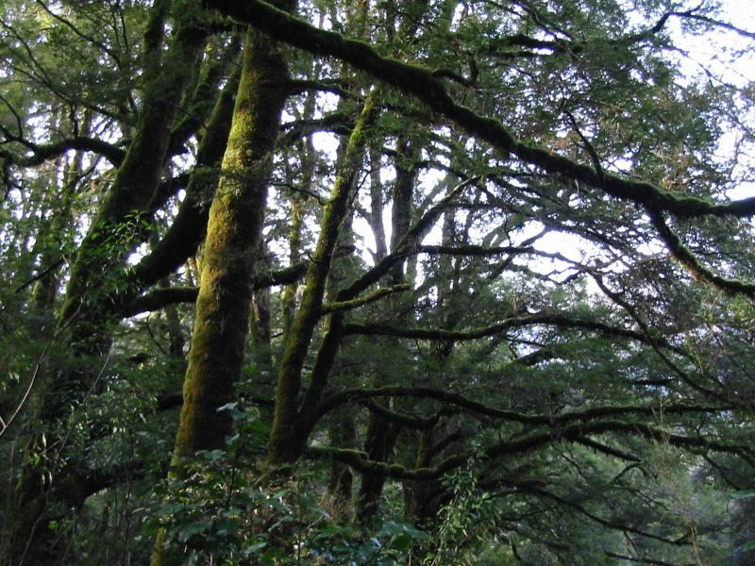

What is Common?

Slide 14
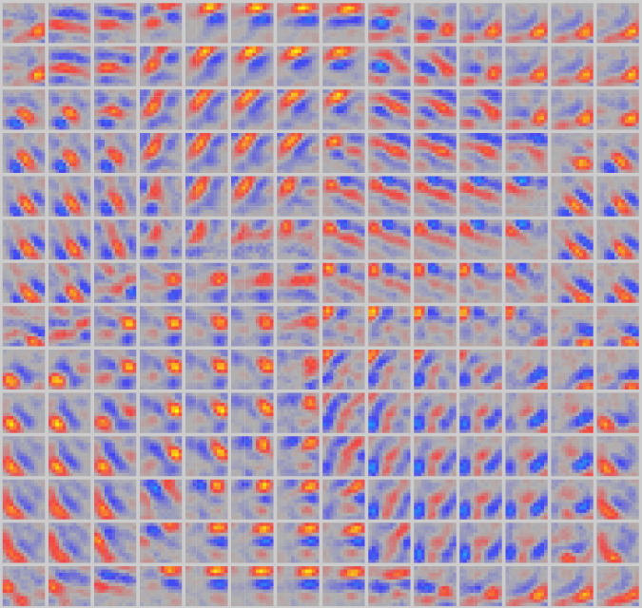
Self-Organized Topography

Slide 15
Invariant Object Recognition

Slide 16
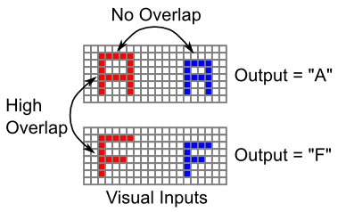
It’s Hard

Slide 17
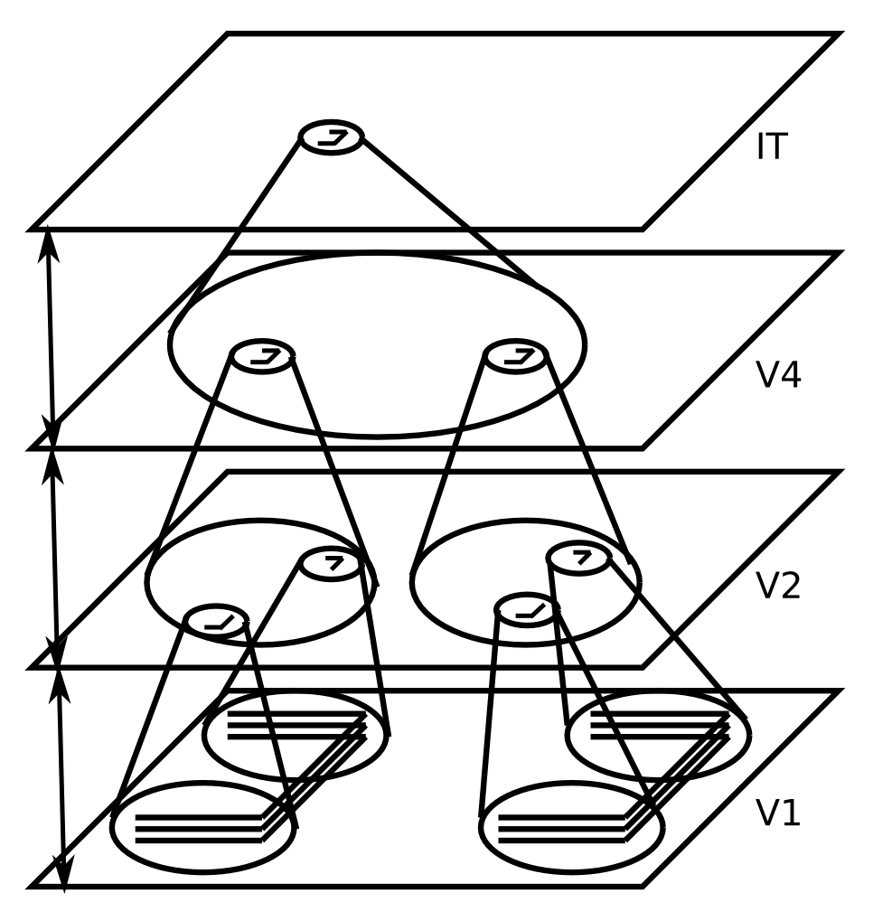
Invariant Object Recognition
Hierarchy of increasing:
Feature complexity
Spatial invariance
Strong match to RF’s in corresponding brain areas
(Neocognitron, HMAX, SLF, Pinto/DiCarlo, etc.)

Slide 18
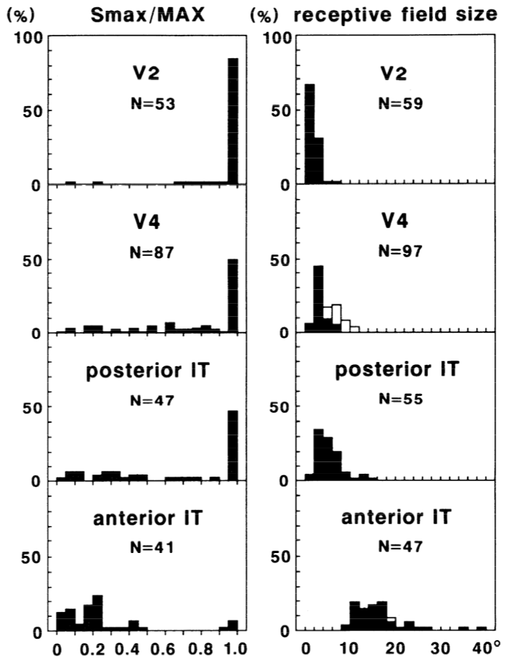
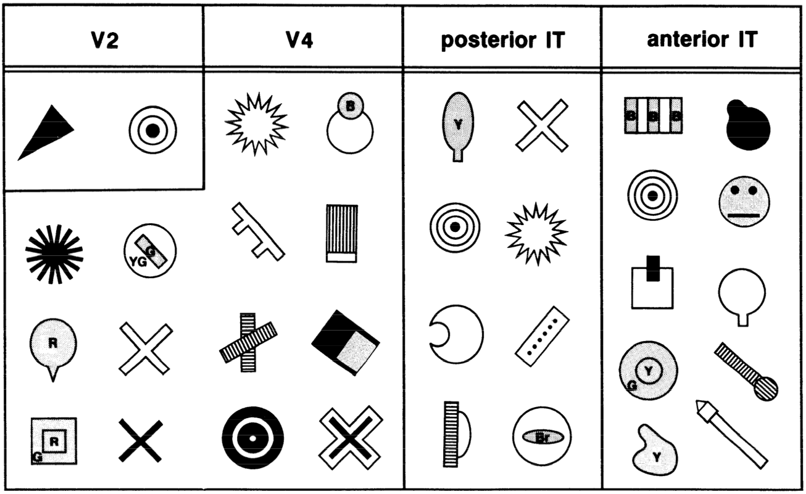
Biological Data
Notes:
Shows how the response to simple visual inputs (Smax) compares to the maximum response to any visual input image tested (MAX), and the overall size of the visual receptive field, over which the neurons exhibit relatively invariant responding to visual features. For V2, nearly all neurons responded maximally to simple stimuli, and the receptive field sizes were the smallest. For V4, only 50% of neurons had simple responses as their maximal response, and the receptive field sizes increase over V2. Posterior IT increases (slightly) on both dimensions, while anterior IT exhibits almost entirely complex featural responding and significantly larger receptive fields.

Slide 19
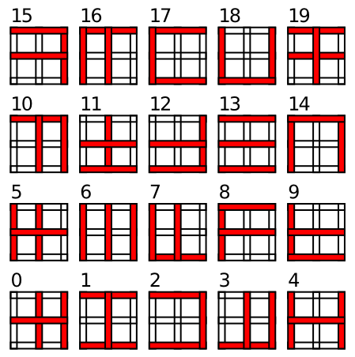
Simple Textbook Test

Slide 20
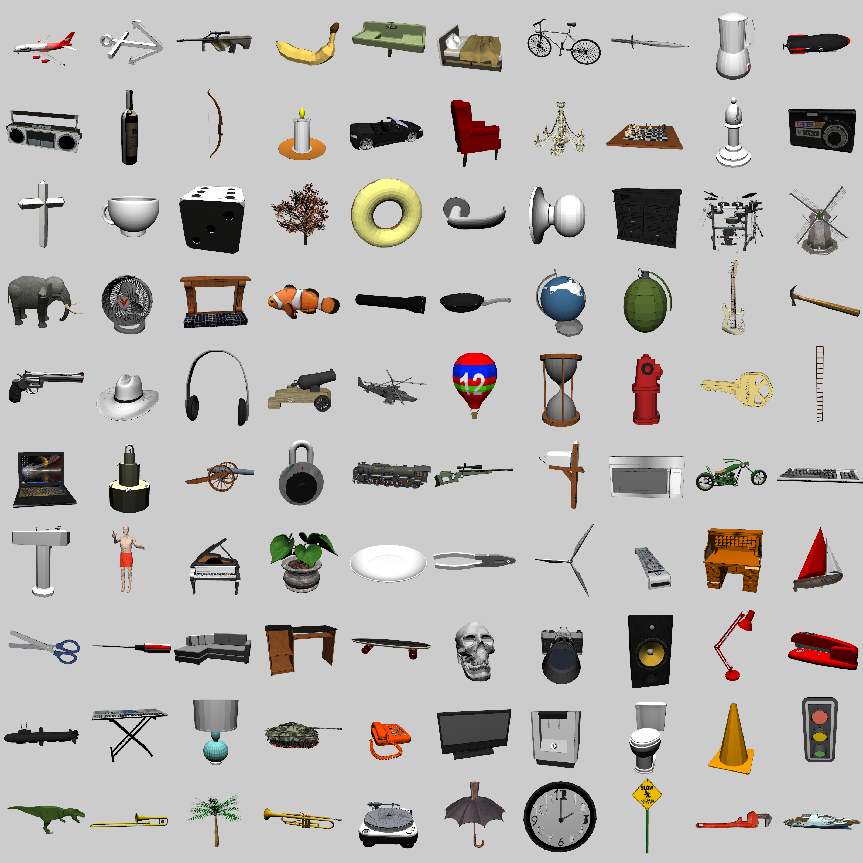
3D Object Recognition Test
3D models from Google SketchUp
100 categories
9-10 objects per category
2 objects left out for testing
+/- 20° horiz depth rotation + 180° flip
0-30° vertical depth rotation
14° 2D planar rotations
25% scaling
30% planar translations
http://grey.colorado.edu/CompCogNeuro/index.php/CU3D

Slide 21
Generalization to Novel Category Exemplars – Better than 90%

Slide 22

Spatial Attention and Neglect

Slide 23
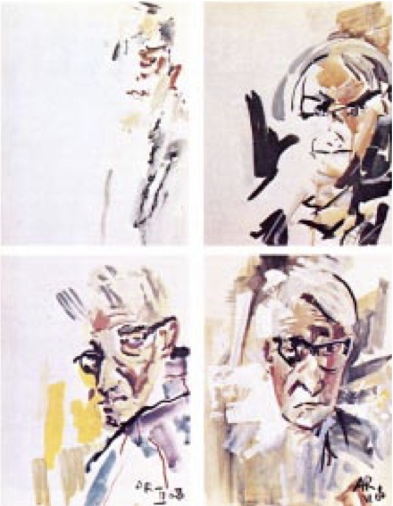
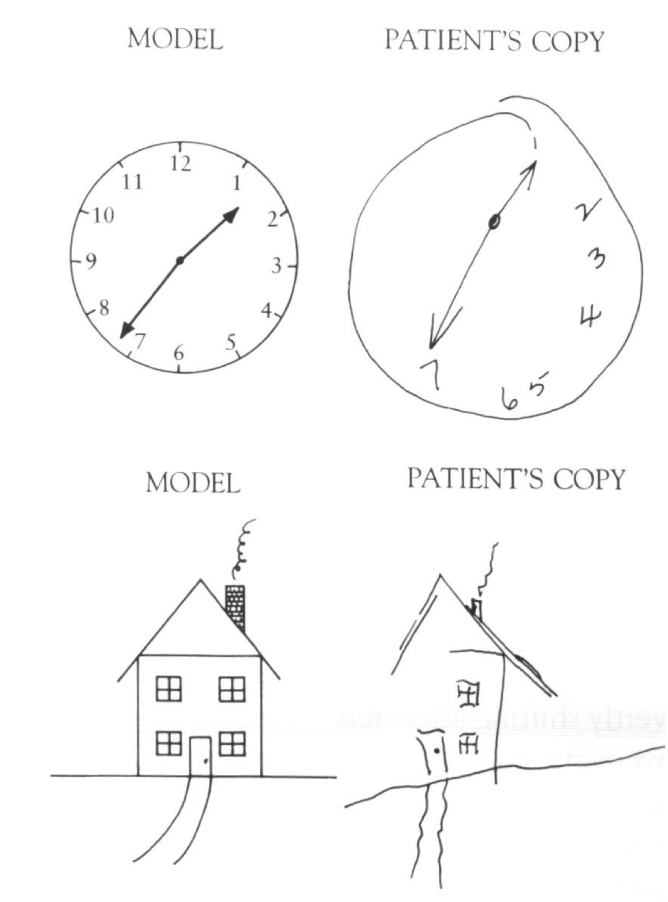
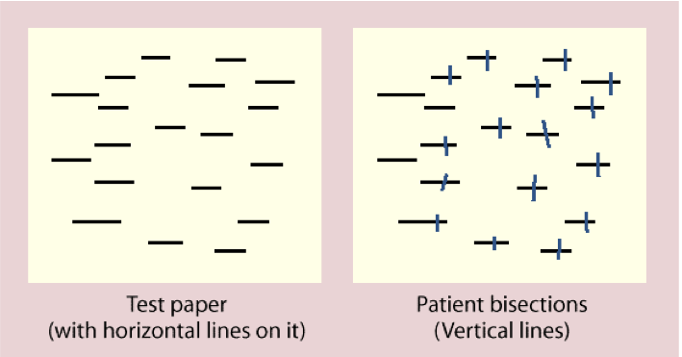
Hemispatial Neglect

Slide 24
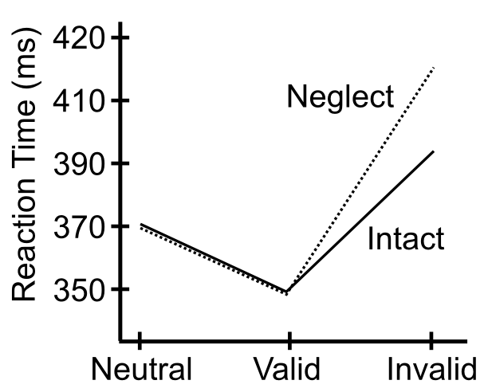
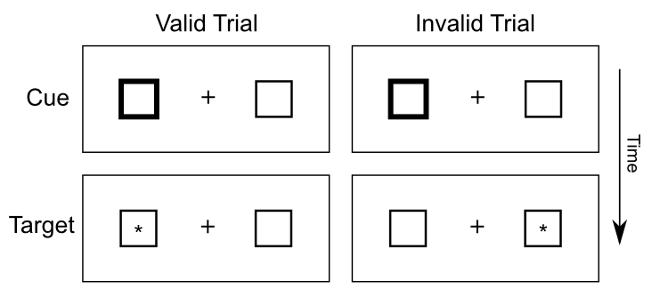
Posner Task

Slide 25
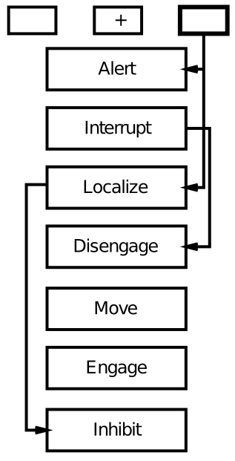
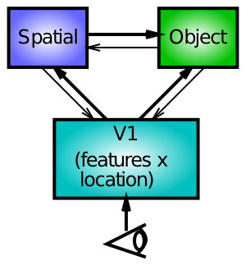
Boxology vs. Biology

Slide 26
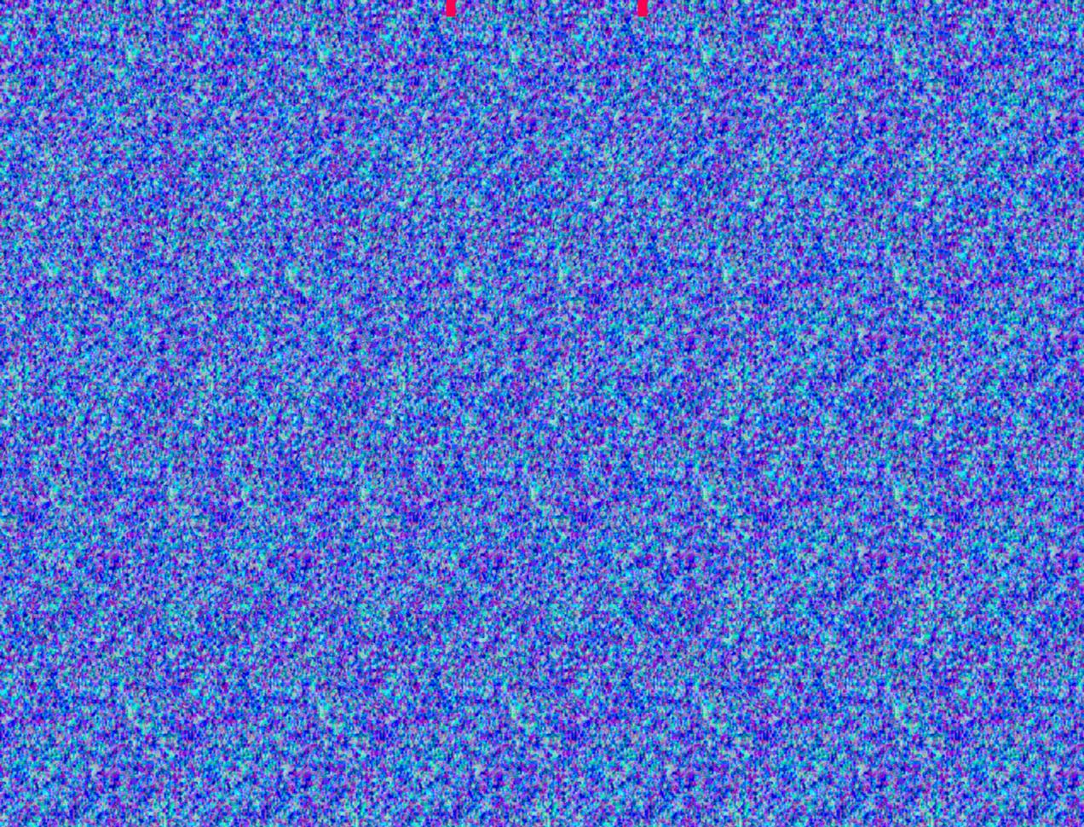
What’s Missing? Lacking Depth..

Slide 27
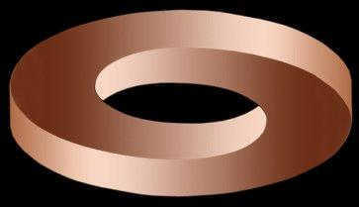
Shape from Shading

Slide 28
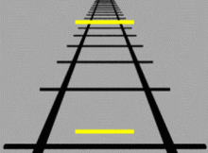
Depth Cues

Slide 29
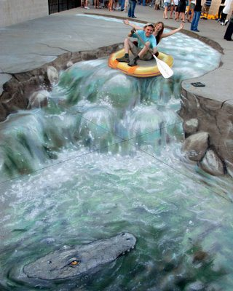
Depth Cues

Slide 30
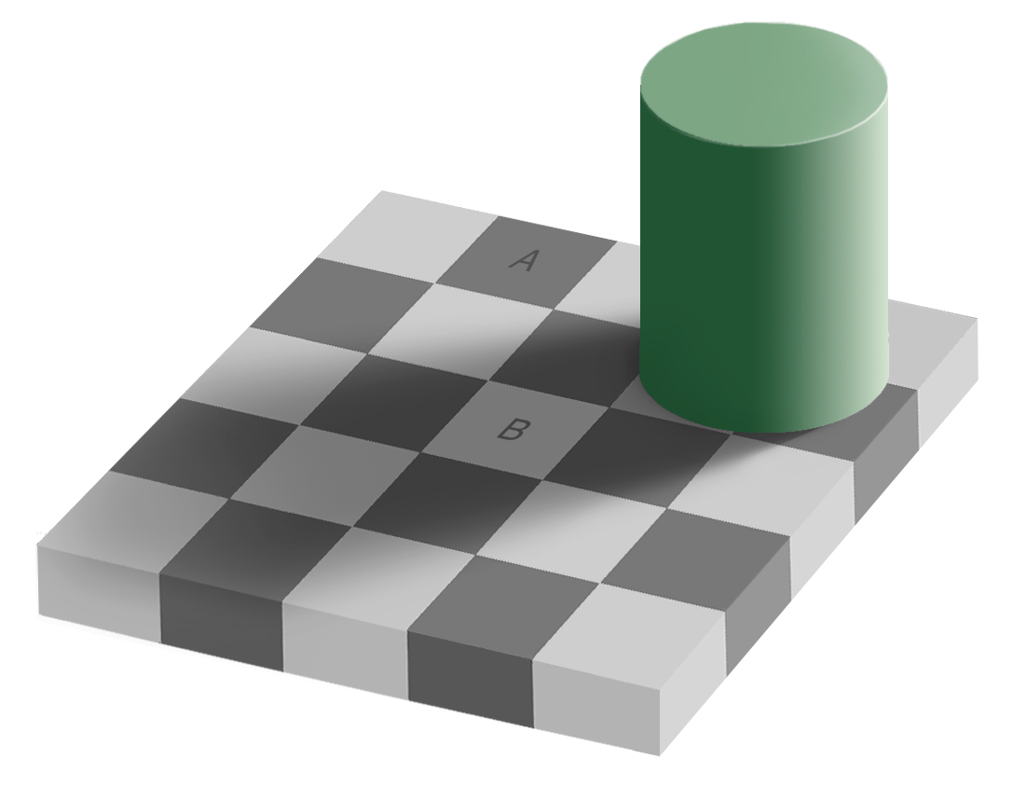
Contrast Illusions
A = B??
No Way!

Slide 31
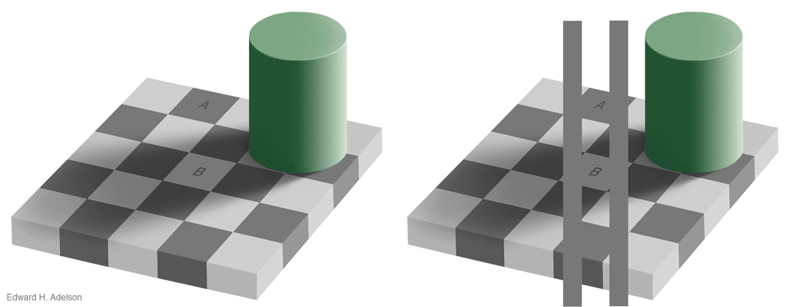
Contrast Illusions
A = B??
No Way!
Way!

Slide 32
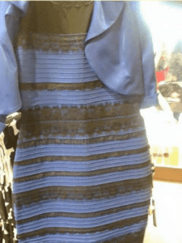
Breakdown in Color Constancy
What do you see?
A. Blue and Black
B. White and Gold
C. Blue and Brown
Notes:
Answer: blue and black!

Slide 33
Edge Detectors Revealed…

